Slide 1
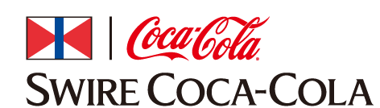
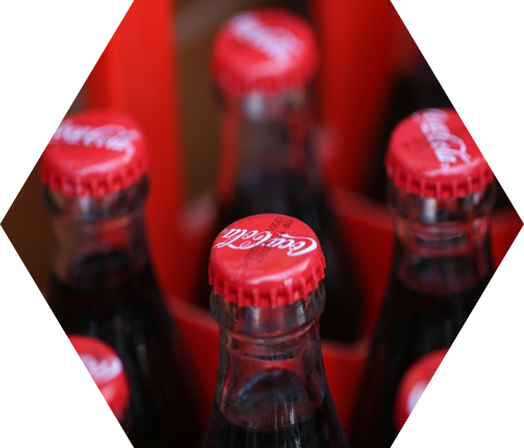



Predict Customer Success Swire Coca-Cola
Project Advisor
Dr. Jeff T. Webb
Charan Kattamanchi

Slide 2


Business Problem Statement
Predict Customer Success
Swire Coca-Cola
Customer
Consumer

Slide 3
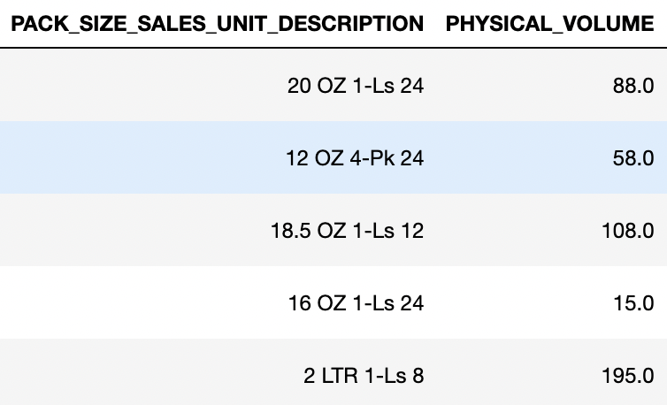
1.Predict Sales Volume
Target Variables Considered
Physical Volume

Slide 4
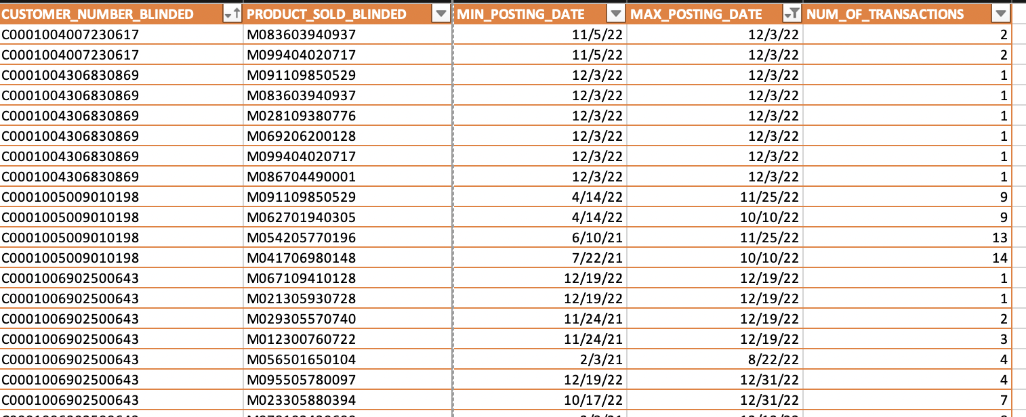
Target Variables Considered
Physical Volume
Number of Transactions

Slide 5
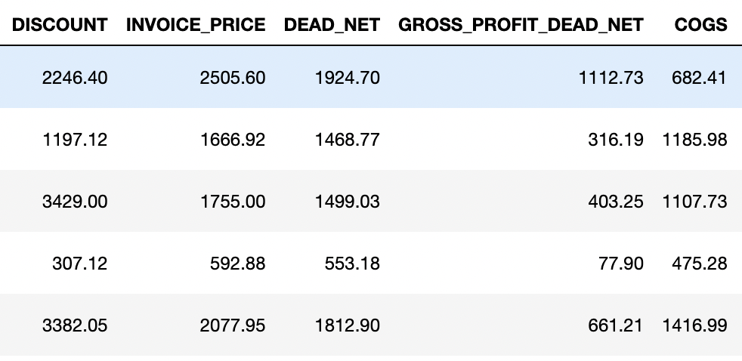
Target Variables Considered
Physical Volume
Number of Transactions
Revenue/Invoice Price

Slide 6
Models Considered
Forecasting
Decision Tree Regressor
Decision Tree classifier

Slide 7
Revenue Categories
Low
Medium
High
Train Test Split

Slide 8
Model
Max_Depth=10
Leaf nodes
Accuracy 56%
Accuracy 65%

Slide 9
2. Predict Longevity
Onboarding date

Slide 10

3.Predict the Popularity (4 or higher in online reviews)
Customer name
Latitude & Longitude

Slide 11
NEXT STEPS
Predict Customer Success
Swire Coca-Cola
Customer
Consumer

Slide 12
1. Consumer
Per Capita Consumption Per City
= Number of Units Sold in the city/Population of city
Limitations:
Pre Covid Vs Post Covid Annual

Slide 13
1. Consumer Per Capita Consumption Per City
2. Customers Per city

Slide 14
1. Consumer Per Capita Consumption Per City
2. Customer Presence
3. Customer Churn
City
Type Of Business
Age
Association with Swire

Slide 15
1. Consumer Per Capita Consumption Per City
2. Customer Presence 3. Customer Churn
4. Successful Customer Business

Slide 16
1. Consumer Per Capita Consumption Per City
2. Customer Presence 3. Customer Churn
4. Successful Customer Business
5. Age
Age of Business itself while Onbaording

Slide 17


Slide 18
Model
Input
Out Put
Model

Slide 19
Revenue Categories
Low <728.99
Medium 729<M<= 12204.99
High >12205
Train Test Split

Slide 20
1. Consumer Per Capita Consumption Per City
2. Customer Presence 3. Customer Churn
4. Successful Customer Business
5. Age
6. Ratings

Slide 21
Per Capita Consumption Per City
Per Customer= (Units in the pack * Physical Volume)
Sum of all customers in the city
Per Capita Consumption per City = Unit Sold per city / City Population

